Slide 1
Introduction to Data Pre-processing
GATK Best Practices for Variant Discovery
Mapping and cleaning up sequence data

Slide 2
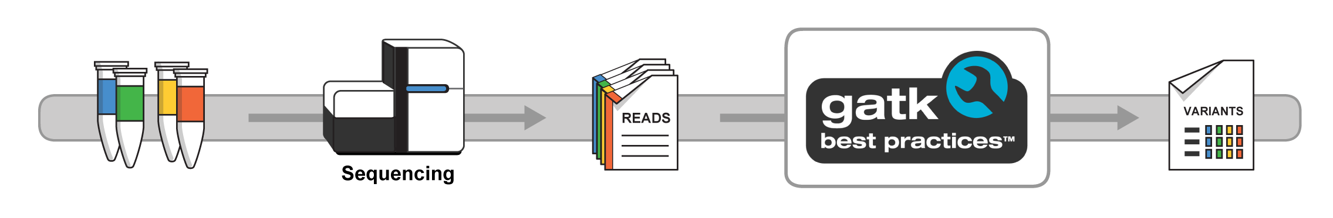
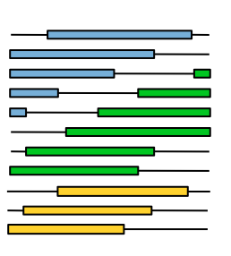
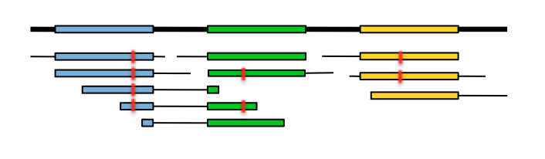

From raw reads to analysis-ready data
Mapping
Marking duplicates
Base recalibration
Reads mapped and cleaned up
List of
variants
Enormous pile of short reads
Notes:
Here we’re talking about the primary analysis: turning a biological sample into DNA sequence data. Note that we’re going to emphasize the experimental designs, data types and formats more than the technology itself. The goal is for everyone to understand the key aspects of the data, where they come from and what it all means for variant calling.
We’re also going to touch on some elements of quality control, which will require anticipating on the early stages of secondary analysis; so spoiler alert, we’ll mention the mapping/alignment of the reads already even though that belongs to the data processing talk that comes after this.

Slide 3
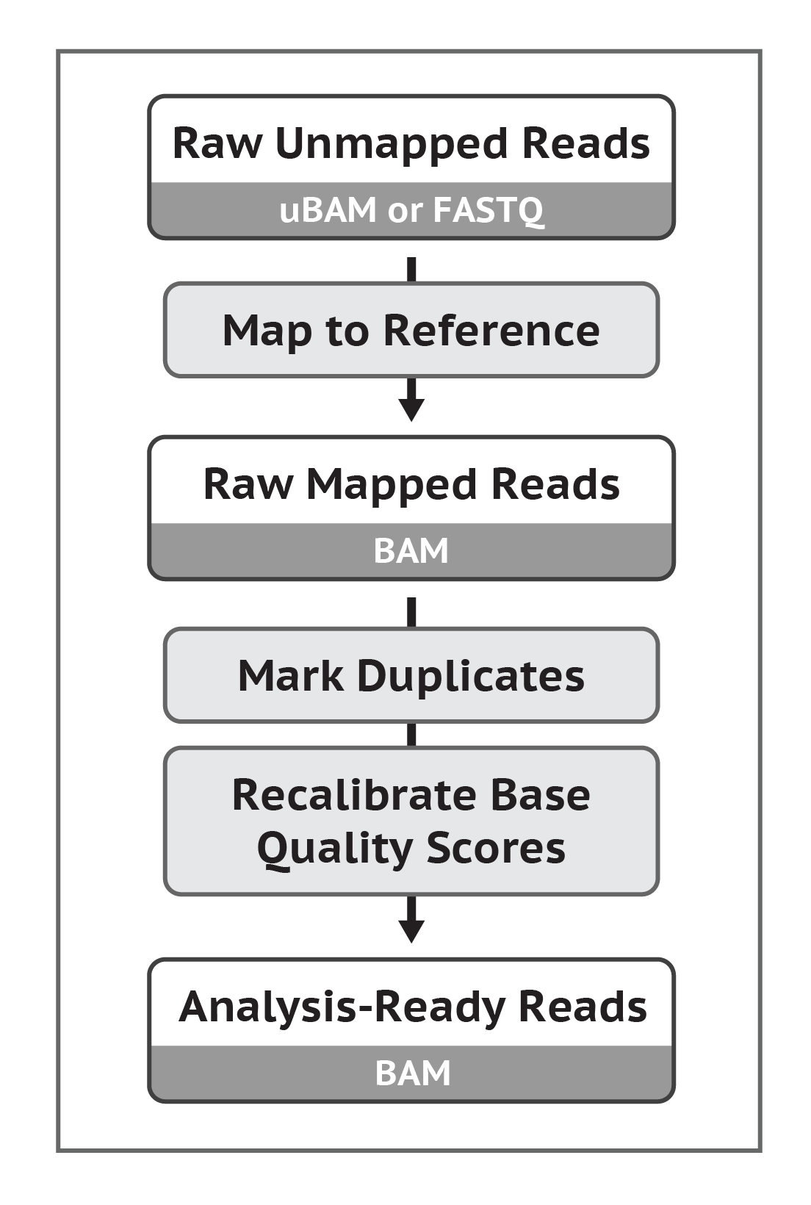
What is data pre-processing?
Data produced by the sequencers:
A huge pile of paired reads without mapping information
Afflicted by various technical biases and artifacts
May include artificial duplicates reads from the same original molecule
Need to map, sort and clean up

Slide 4

Step 1: Map the reads produced by the sequencer to the reference
Mapping and alignment algorithms
BWA for DNA
STAR for RNAseq
Enormous pile of short reads from sequencer
Reference genome
Reads mapped to reference
Notes:
BWA – BWA used for exomes, BWA-MEM for WGS

Slide 5
Goal: align the sample genome to the reference genome
Region 1
Region 2
Region 3
Reference
Sample
truncated region
duplicated region
= local variant (SNP/indel)
…But we don’t have the whole sample in one piece.

Slide 6
So we have to map each little bit one by one
Region 1
Region 2
Region 3
Enormous pile of short reads
Easy
Notes:
Most parts of the genome don’t look like other parts of the genome – relatively easy to align to the reference (3 billion)
(many million reads to align to 3 billion)
About ½ the cost is done during the mapping/alignment

Slide 7
Complication: mismatches, indels, duplicated regions…
Region 1
Region 2
Region 3
Enormous pile of short reads
Easy
Region 1
Region 2A
Region 2B
Harder
Notes:
In the reference there might be duplications. We don’t know which region it came from (some tricks can be helpful)

Slide 8
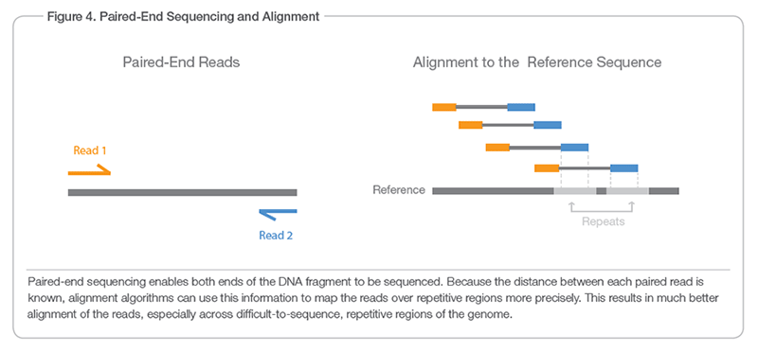
Paired-end sequencing helps a lot
https://www.illumina.com/science/technology/next-generation-sequencing/paired-end-vs-single-read-sequencing.html
Notes:
When a repeat exists in the reference, paired reads give more context as to which segment it maps to
Collects stats on the average length of molecule segment (and uses it to break ties)

Slide 9
Output format: Sequence/Binary Alignment Map (SAM/BAM)
HEADER lines starting with @ symbol describing various metadata for all reads
BAM header line
@HD VN:1.6 SO:coordinate
@SQ SN:seq1 LN:394893
@SQ SN:seq2 LN:92783
@RG ID:A SM:SAMPLE_A
Reference sequence dictionary entries
Read group(s)
RECORDS containing structured read information (1 line per read/record)
read name
position
CIGAR
read sequence
metadata
SLX1:1:127:63:4 99 1 10052169 60 23M6N10M = 14 10 GAAGATACTGGTT 768832'48:::: RG:Z:A …
flags
MAPQ
mate information
PHRED quality scores
Added mapping info summarizes position, quality, and structure for each read
Mate information points to the read from the other end of the molecule (other in a pair)
http://samtools.github.io/hts-specs/SAMv1.pdf
Notes:
Header – metadata that pertain to all reads in the file
Record – data for a single read
Flags – encodes binary information about read and mate: strand +/-, Read number ½, un/mapped, duplicate yes/no, etc.

Slide 10
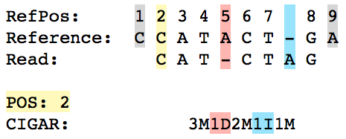
CIGAR summarizes alignment structure
CIGAR = Concise Idiosyncratic Gapped Alignment Report
read1 99 ref 2 30 1S3M1D2M1I1M = 14 20 CATCTAG …
T
1S
Notes:
POS: alignment start position (not including soft clipping)
Note that M is an alignment match, which means that there can still be a base mismatch (unlike = or X)

Slide 11
Implementation note: Regular FASTQ -> BAM workflow
Alignment metadata
Reference genome
BWA MEM
Mapped BAM
FASTQ
! Adding Readgroup metadata requires additional step or injection of metadata into BWA command
Notes:
Normally the sequencer produces a fastq file
Fastq does not have readgroup infomation

Slide 12
Implementation note: Unmapped BAM -> BAM workflow
Alignment metadata
Reference genome
ALL THE METADATA!
Readgroup metadata
BWA MEM
Mapped BAM
Mapped, cleaned,
sorted BAM
MergeBamAlignment
combines info + does some extra cleanup
Unmapped BAM
Notes:
At the Broad we don’t like separating the metadata from the data
So we extract an unmapped BAM from the sequencer (called illumina base calls to SAM)
BWA mem doesn’t accept a bam file – only fastq
We convert unmapped bam to fastq (in memory), run through bwa mem and then reassociate the metadata (merge bam alignment)

Slide 13
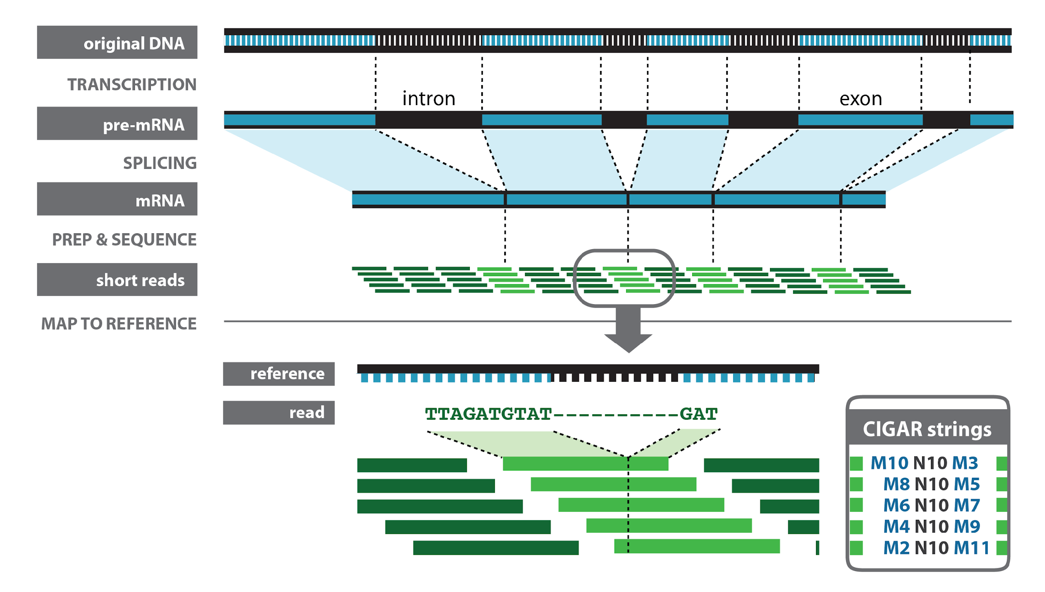
Special handling for RNAseq splice junctions
Notes:
RNA data is a bit of a special case due to these intronic regions
N in cigar
Look for splice sites– information that helps us identify the transcript the molecule came from
There is a standard db of splice sites (info to mapper), but also denovo splice site
Those might be the interesting thing about your data
N10 – intron (100s to 1000s of bases)
Problematic for gatk which is used to working within a small window
So there is some special handling, a different aligner (STAR) and a separate pipeline – see docs for details.

Slide 14
Step 2: Mark duplicates to mitigate duplication artifacts
Duplicates = non-independent measurements of a sequence fragment
-> Must be removed to assess support for alleles correctly
Reference
Mapped reads
Picard MarkDuplicates
= error propagated in duplicates
Notes:
Non-independent measurements of sequence
Sampled from single template of DNA
Violates independence assumptions made in variant calling
Errors in sample/library preparation are propagated to all the duplicates
----
PCR duplicates – a physical DNA fragment was duplicated during library preparation (PCR step) and two copies happened to get sequenced
Optical duplicates – sequencer misinterpreted a single cluster as two separate clusters
Marking – tag is added to the sequence record, but records are NOT thrown out

Slide 15
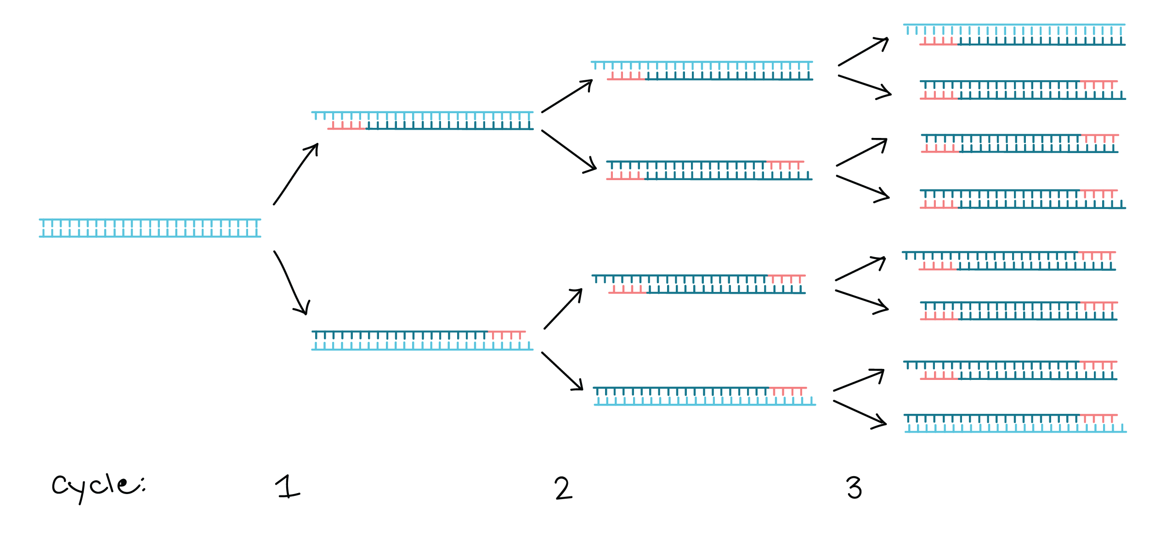
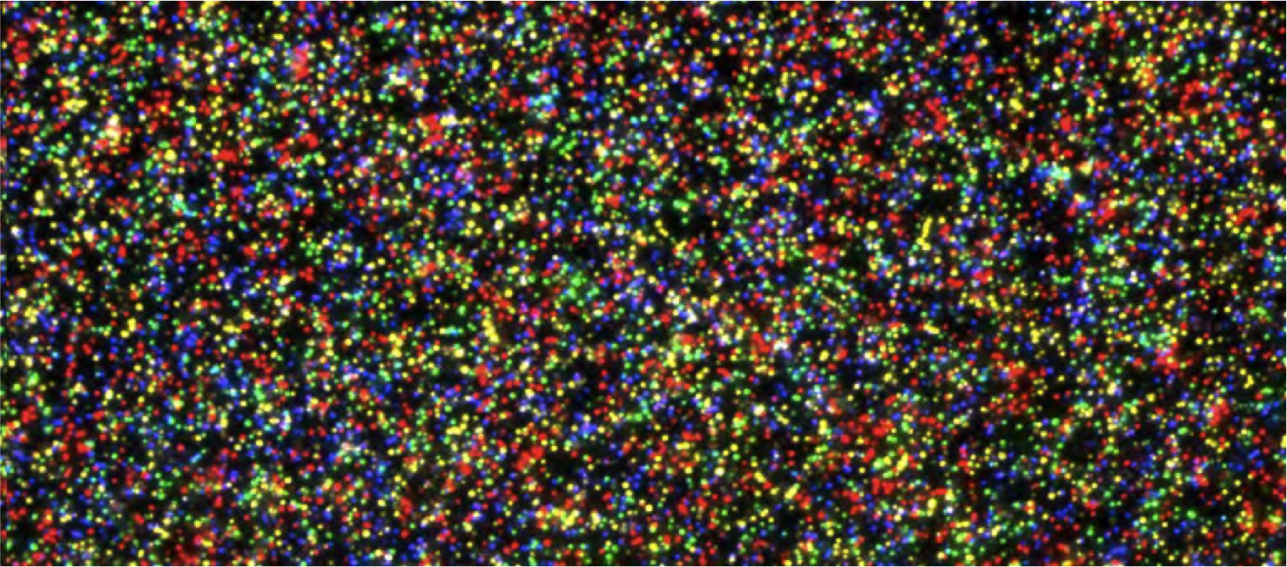
Where does the duplication come from?
LIBRARY DUPLICATES
Caused by PCR
OPTICAL DUPLICATES
Occur during sequencing
https://www.khanacademy.org/science/biology/biotech-dna-technology/dna-sequencing-pcr-electrophoresis/a/polymerase-chain-reaction-pcr
https://depts.washington.edu/molmicdx/mdx/tests/NGS16S.shtml
Notes:
Library duplicates are made if you do PCR in your protocol: creates copies of fragments to increase the probability that each fragment is read– but the flipside of this is that you’re likely going to read a bunch of the copies
Optical duplicates are an artifact of the sequencer.
-The sequencer does “PCR” on the flowcell to generate little clusters of the same fragment to increase fluorescence for the detector to pick up.
-Aberrations in cluster formation cause optical duplicates
--------------------
(Library and Optical duplicates are distinguished to estimate the number of unique pieces of DNA in the Library )

Slide 16
Identify duplicates using orientation + “unclipped” 5’ position
Pos 1 2 3 4 5 6 7 8 9
Ref T A G C C G A T C
r1 T A G C C G A
r3 T A – C CAG A
r5 T A G C C G A T C
r6 S S G C C G A
- Grey bases are clipped
- Underlined is the expected 5’ start of the read
2^{nd of pair} mates (in orange) are shown as identical but they could display the same variations as the 1^{st of pair} mates
Coming from the same input DNA template -> assume reads have same start position
Choose representative read based on base quality scores and other criteria; mark others
Notes:
Here’s a set of duplicates based on their start position.
----
Accessory things to point out:
-indels, sequence of bases etc. don’t matter – those things could be introduced by PCR / other sequencing errors. This is probably the most non-intuitive / confusing thing about marking duplicates.
-hard vs. soft clipping: specified by the aligner (BWA). soft clipping is usually when one section of the read maps to a genomic region much more poorly than the rest, so we just ignore that section. hard clipping is usually when a section of the read maps somewhere else in the reference (chimeric alignment)
You almost never have two reads with the same start/end location, especially when doing paired ends, so don’t worry about limiting depth
Use cases where you may NOT want to mark duplicates
Amplicon sequencing (or any other library construction with non-random starts)
All reads start at same position by design
If have UMI, can use UMIAwareMarkDuplicatesWithMateCigar
RNAseq (allele-specific) expression analysis (alternatively, ASEReadCounter can disable DuplicateFilter)

Slide 17
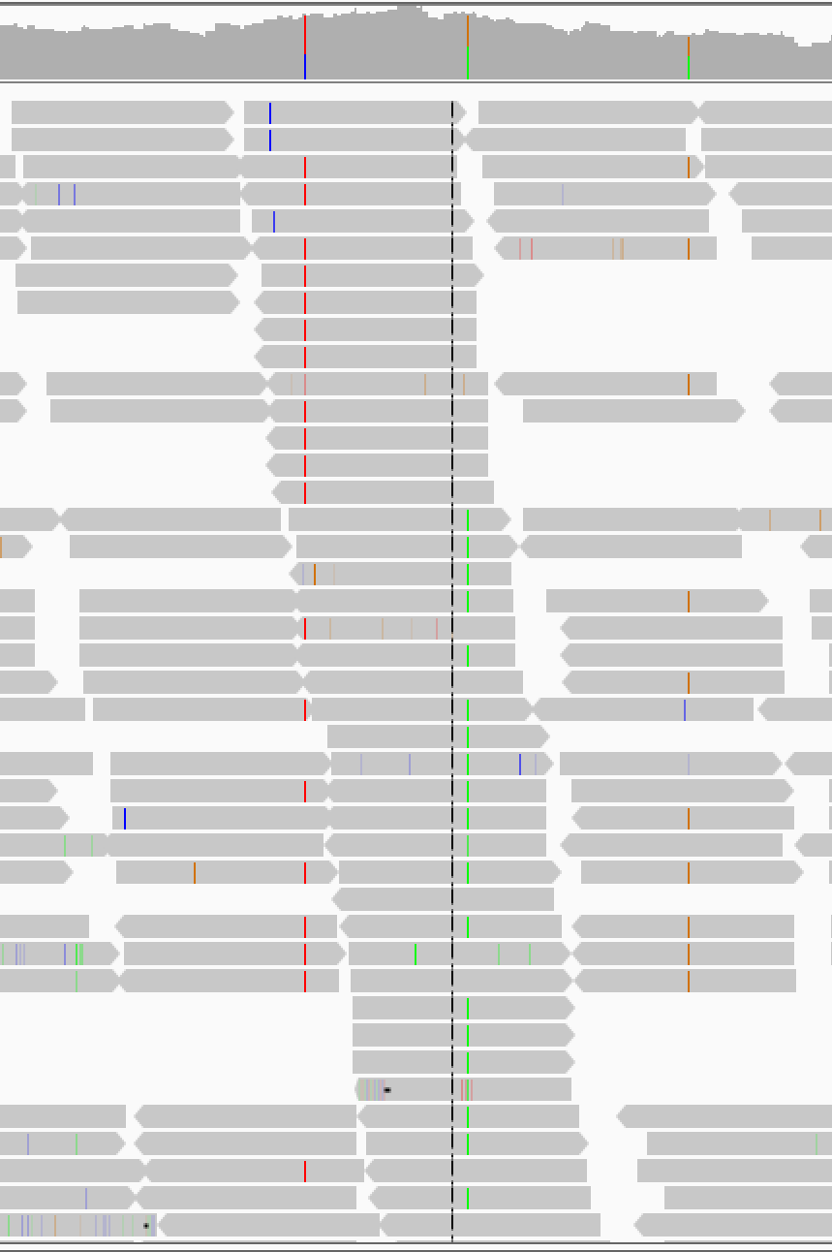
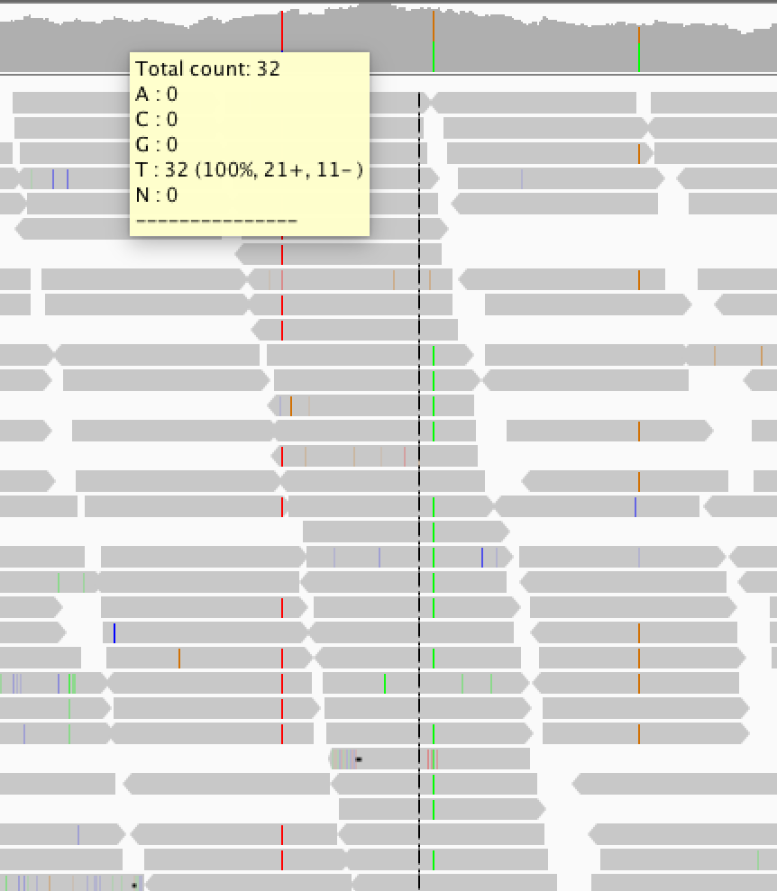
Marking duplicates allows us to ignore those reads
Showing duplicate reads
Hiding duplicate reads
Duplicate status is indicated in SAM flag
Duplicates are not removed, just tagged (unless you request removal)
Downstream tools can read the tag and choose to ignore those reads
Most GATK tools ignore duplicates by default
Notes:
Dupes are MARKED, not REMOVED

Slide 18
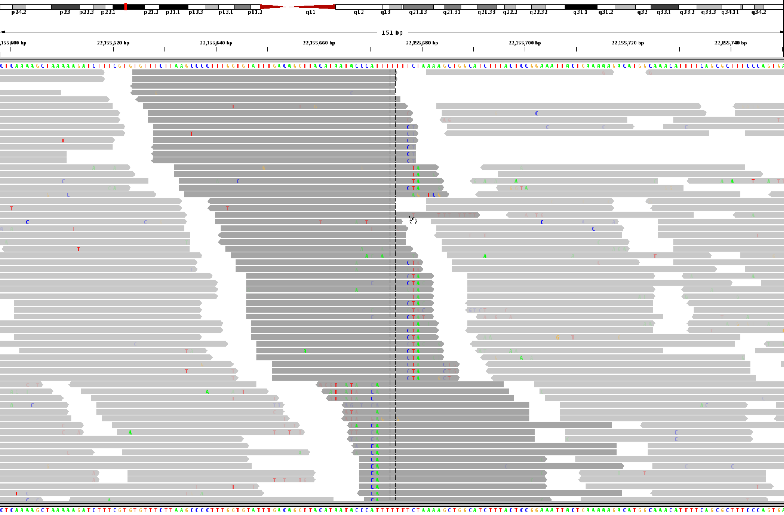
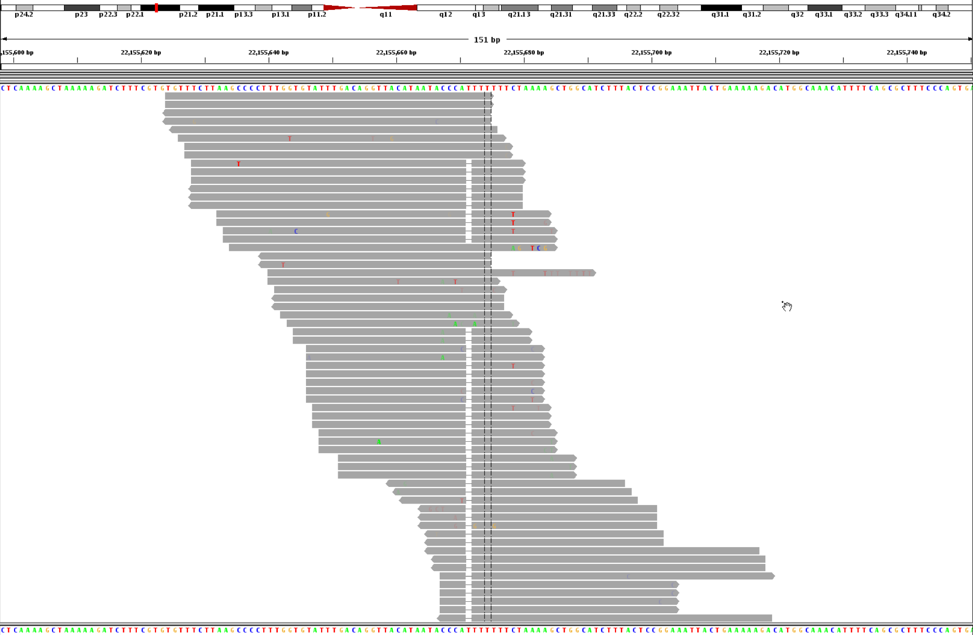
DEPRECATED: Local realignment around indels
Several consecutive SNPs only found on reads ending on the right of the homopolymer
BEFORE
Several consecutive SNPs only found on reads ending on the left of the homopolymer
7bp homopolymer run
AFTER
Not necessary when using assembly-based variant callers
Adding a 1-bp insertion
brings sanity to the entire alignment
* For implications, see <https://gatkforums.broadinstitute.org/gatk/discussion/7847/changing-workflows-around-calling-snps-and-indels>
Notes:
We used to have this step. Not needed any more since both HaplotypeCaller (for germline) and Mutect2 (for somatic) use local reassembly which isn’t confused by these indel artifacts like some other pileup based tools.

Slide 19
Step 3: Base Recalibration (BQSR) corrects for machine errors
Sequencers make systematic errors in base quality scores
Sequencer quality cannot include PCR-based errors
BQSR corrects the quality scores (not the bases)
Overall effect of bias
Bias on nucleotide context
Notes:
Systematic biases can be seen in batches, on a certain type of sequencer, etc. You want to adjust for those biases so that you can confidently compare quality scores across different runs & machines. We have a way to calculate the error empirically and find patterns in how error varies with basecall features.
Dinucleotide context covariate example: quality depends on (co-varies with) the combination of current and following bases. The dinucleotide context example should speak to the biologists in the audience. “If you have two As in a row, this machine usually underestimates their base qualities. With a C and a G in a row it’s even worse.”
Briefly explain how we know this – difference between empirical and reported quality. Measure of empirical quality is key part of the recalibration process.
This has big implications for variant calls because instead of the errors being spread out randomly, they’ll be concentrated at specific positions. So the calls made for those positions are likely to be bad a lot of the time.
----
Context dependence - empirical error rate is a function of surrounding bases (usually 2 or 3)
Empirical error – estimated by comparing mapped reads to the reference

Slide 20
How do we calculate the empirical qualities?
Any sequence mismatch = error except known variants*!
Keep track of number of observations and number of errors as a function of various error covariates
(lane, original quality score, machine cycle, and sequencing context)
PHRED-scaled quality score
* If you don’t have known variation, bootstrap it!
Notes:
Consider any sequence mismatch as an error in your process, except for known variants.
Known variants come from a list of common variant sites. If this list isn’t available, bootstrap calls for the sample without BQSR and use those calls as your “known variants”
Track the number of observations and number of errors along the covariate context you are examining
Calculate the quality score! This is the adjustment BQSR make when applied, given this covariate context
(The +1 and +2 represent priors that cause the error probability to default to 0.5 if a certain covariate is not observed)

Slide 21
Example recalibrated SAM record with OQ tag
Recalibrated Base Qualities
ACCTTCCCCCAGCCCCTACCCCCAGACAGGCCCCGGTGTGTTGTGTTCCCCTCCCTCTGTCCATGTGTTCTCATTGTTCAACTCTCATTTATGAGTGAGAACATCGGGGGTTTGGTTTTCTGTTCTTGGATTAGTTTGGTGAGAATGATGG <;<>==>=>>6>=>>>??+<>>>?3::*<>8=>>8?/=.3/7;<<;>=???>???@=1=>=?+=>?=.<=A@;??,>?=;4:?>1>+>=?:@=>?/;4??<@+??9<;+8/<-,?:<@>:@=/-.@>=@9/?)=6???+:@=B=####### MC:Z:151M MD:Z:108T29C12 PG:Z:MarkDuplicates.4 RG:Z:H01PE.2 NM:i:2 MQ:i:0 OQ:Z:AAFFAFJFJJ<FFJJJJJ-AJJJJ7AA-AJ<FJJJJ-F-7-<AAAAJFJJJFJJJJF-FFFJ-FFJF-FFJJAJJ-FJAA7AAF-F-FFJAJAFF-A7FFAJ-FFFAA-<-A--F<AJF<FA---AFAF<-F-A7FFF-<FAJA####### UQ:i:24 AS:i:141
Original Base Qualities
Notes:
At Broad and other major centers, we no longer store the base qualities as we have found them to to take too much space….

Slide 22
Recap: From raw reads to analysis-ready data
Mapping
Marking duplicates
Base recalibration
Reads mapped and cleaned up
List of
variants
Enormous pile of short reads
Notes:
So we covered all of this and now we have analysis-ready data that we’re ready to feed into the actual variant calling pipeline(s)

